Slide 1
WELCOME TO MY CLASS

Slide 2
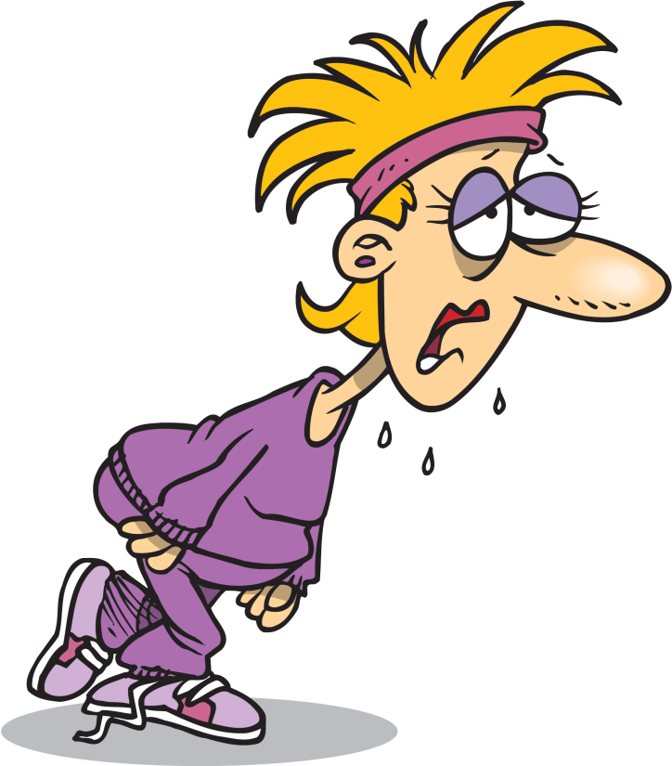
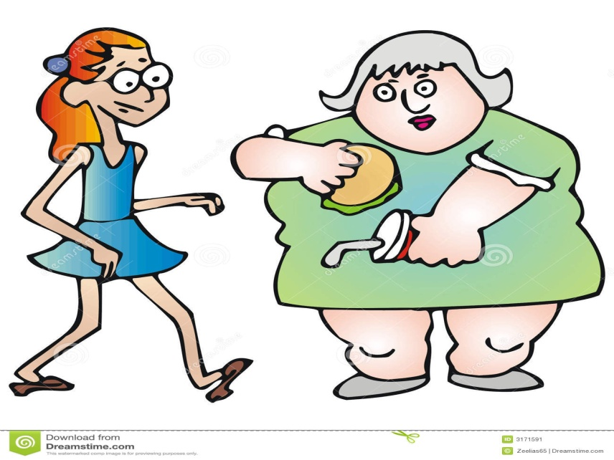
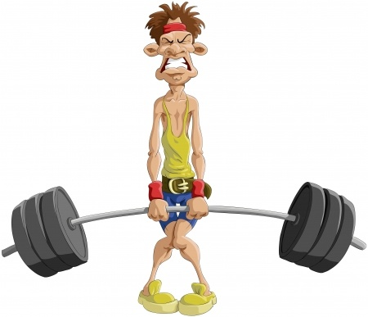
* WARM UP
T
H
I
N
1
T
I
R
E
D
2
3
W
E
A
K
L
A
Z
Y
4
5
F
A
T
H
A
P
P
Y
6

Slide 3
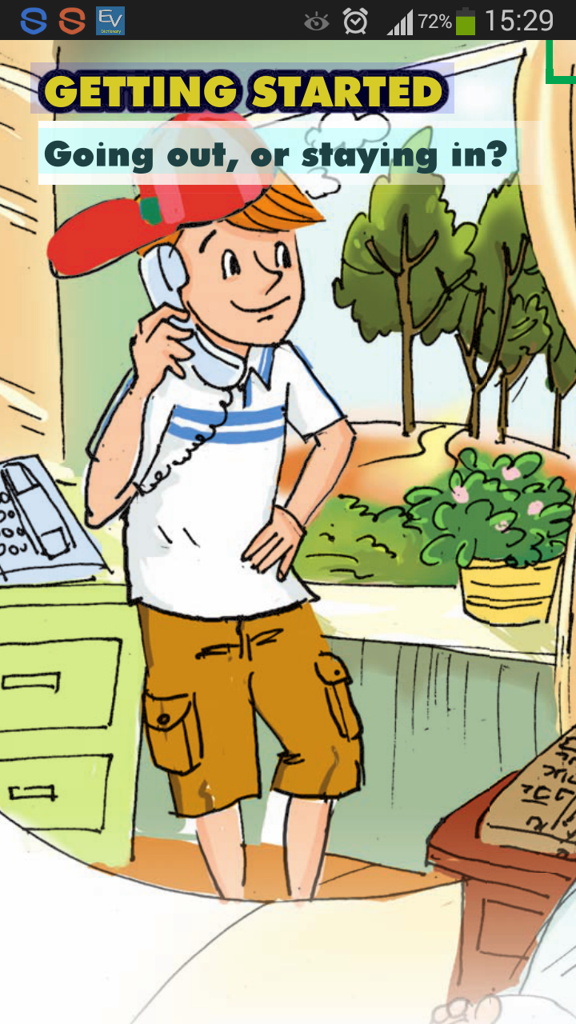
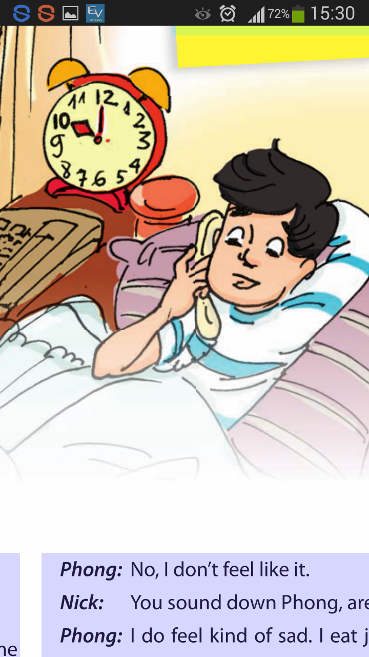
Unit 2. HEALTH
Lesson 1. Getting started

Slide 4
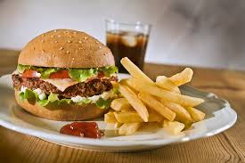
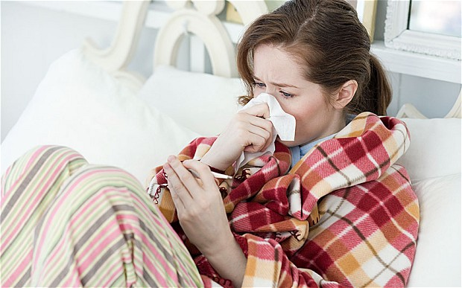
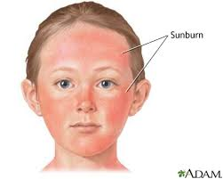
I. Vocabulary:
- health (n)
: sức khỏe
- healthy (n)
: khỏe mạnh
- junk food (n)
: đồ ăn nhanh, quà vặt
- sunburn (n)
: cháy nắng
- sunburnt (adj)
: rám nắng
- Put on weight : tăng cân
- Flu (n): cảm cúm

Slide 5
1a. Can you find a word or expression that means:
Nick: | Hi, Phong.
Phong: | Oh, hi. You woke me up, Nick.
Nick: | But it’s ten o’clock already. Let’s go out.
Phong: | No, count me out. I think I’ll stay at home and play Zooniverse on my computer.
Nick: | What? It’s such a beautiful day. Come on! You already got enough sleep. Let’s do something outdoors- it’s healthier.
Phong: | What like, Nick?
Nick: | How about we go swimming? Or cycling. They are both really healthy.
Phong: | No, I don’t feel like it.
Nick: | You sound down Phong, are you OK?
Phong: | I do feel kind of sad. I eat junk food all the time, so I’m putting on weight too.
Nick: | All the more reason to go out.
Phong: | No, Nick. Plus, I think I have flu- I feel weak and tired. And, I might get sunburnt outside.
Nick: | I won’t take no for an answer. I’m coming to your house now!
1. A name of a computer game
2. I don’t want to.
3. Feeling sad.
4. Become fatter.
5. I don’t accept.

Slide 6
1b. Read the conversation again. Who wants to do the following things?
Nick: | Hi, Phong.
Phong: | Oh, hi. You woke me up, Nick.
Nick: | But it’s ten o’clock already. Let’s go out.
Phong: | No, count me out. I think I’ll stay at home and play Zooniverse on my computer.
Nick: | What? It’s such a beautiful day. Come on! You already got enough sleep. Let’s do something outdoors- it’s healthier.
Phong: | What like, Nick?
Nick: | How about we go swimming? Or cycling. They are both really healthy.
Phong: | No, I don’t feel like it.
Nick: | You sound down Phong, are you OK?
Phong: | I do feel kind of sad. I eat junk food all the time, so I’m putting on weight too.
Nick: | All the more reason to go out.
Phong: | No, Nick. Plus, I think I have flu- I feel weak and tired. And, I might get sunburnt outside.
Nick: | I won’t take no for an answer. I’m coming to your house now!
Phong
1. Stay at home.
Phong
2. Play computer games
Nick
3. Go outside
Nick
4. Go swimming
Phong
5. Avoid getting sunburnt

Slide 7
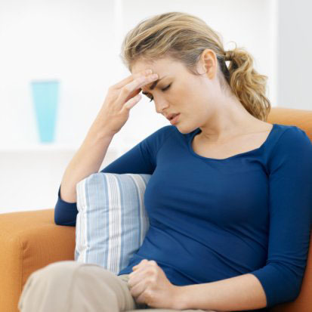
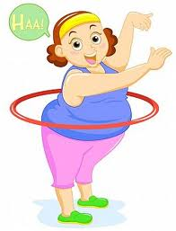
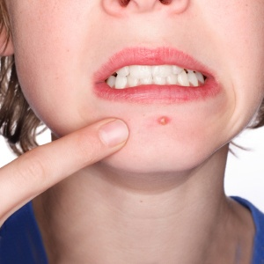
Ex 2a. Match the health problems in the box with the pictures.
a. spots
b. sunburn
e. sunburn
c.(put on) weight
b. (put on) weight
c. flu
d. (an) allergy
f. sickness

Slide 8
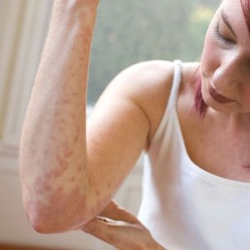
(an) allergy
sickness
flu
(put on) weight
sunburn
spots

Slide 9
HEALTH Problems

Slide 10
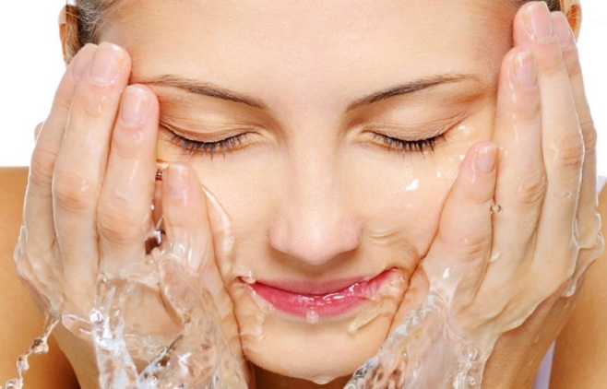
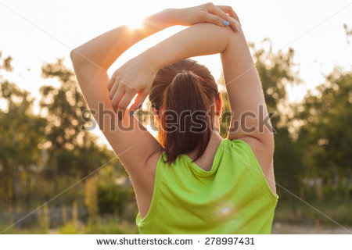
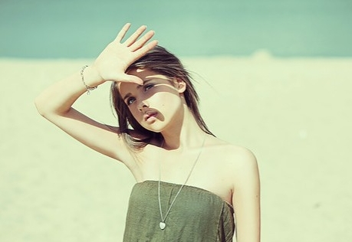
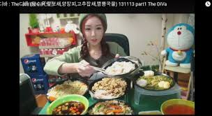
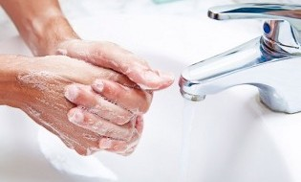
3. Match the correct advice (1-5) with the people (a-e)?
a
b
c
4. Exercise regularly
5. Wash your face regularly.
1. Wear a hat
ADVICE
e
d
3. Be careful with what you eat and drink
2. Wash your hands regularly

Slide 11
Exercise regularly
ADVICE
Wash your face regularly.
Wash your hands regularly
Wear a hat
Be careful with what you eat and drink
allergy
spot
flu
HEALTH PROBLEMS
put on weight
sunburn

Slide 12
Ex 4: Game
Example:
A: I think I have spots.
B: Oh, I’m sorry. My advice is “ Wear a hat”.

Slide 13
Thank you

