Slide 1
Period 10: Unit 2: Health
Lesson 2: A closer look 1

Slide 2
I. VOCABULARY.
1. cough (n): bệnh ho
2. temperature (n) = sick (adj): ốm, sốt
3. sneeze (n): sự hắt hơi
4. ache (n) = sore (adj): đau
Eg: headache, stomachache, toothache, earache..
sore throat (đau họng), sore eyes..

Slide 3
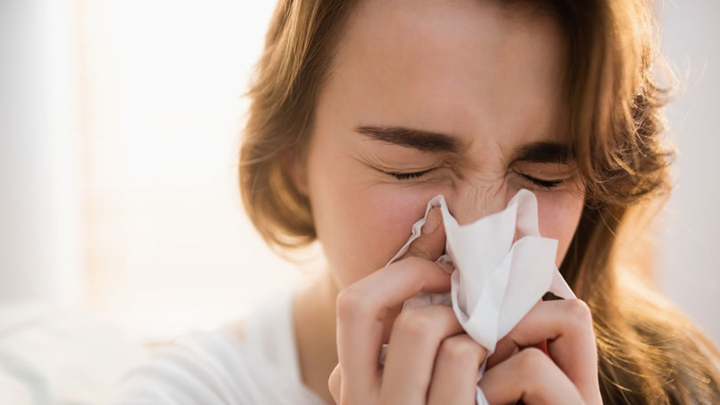
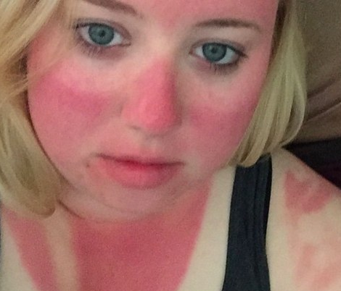
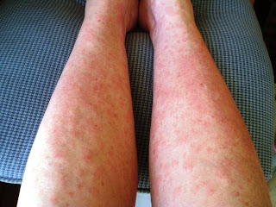
1. Look at the pictures and write the problem below the picture of each patient.
flu
1.
2.
sunburn
3.
allergy
4.
tired / weak

Slide 4
2. Read the doctor notes about his patients and fill in the missing words
Patient 1: She looks very red. She was outdoors all day yesterday. I think she has____________.
Patient 2: He keeps sneezing and coughing. I think he has___________.
Patient 3: He looks so_________. He can’t keep his eyes open! He’s very hot too – he has a __________.
Patient 4: he ate some seafood yesterday. Now he feels __________. He says he has a _________________ too
Patient 5: He is holding his neck. I think he has a _________
sunburn
flu
tired
temperature
sick
stomachache
sore throat

Slide 5
3. Role-play the meeting with the doctor. Use the cues in 1,2 or your own health problem.
Eg:
You : Hi Doctor Thao
Dr. Thao: Hi Hung
You : I was outside all day yesterday. I feel
very hot and my face is red
Dr. Thao: I see. I think you have a sunburn.

Slide 6
II. PRONUNCIATION : /f/ and /v/
5. Listen and circle the words you hear:
 | /f/ | /v/
1 | fat | vat
2 | ferry | very
3 | fast | vast
4 | fault | vault
5 | safe | save
6 | leaf | leave

Slide 7
6. Listen and circle the words with the /f/ or /v/ sounds. Then say the sentences.
Fast food isn’t healthy.
I have felt sick all day.
Obesity is a problem – people are getting fatter.
Having a healthy lifestyle is important.
Too many sweets give you toothache.

Slide 8
HOMEWORK
Learn by heart the new words.
Do exercises in workbooks.
Prepare “A closer look 2”.

