Slide 1




WELCOME TO OUR CLASS

Slide 2
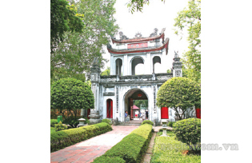
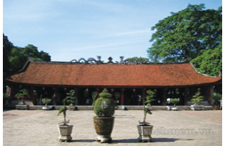
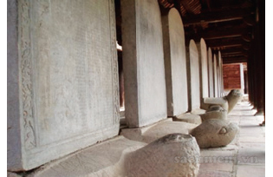
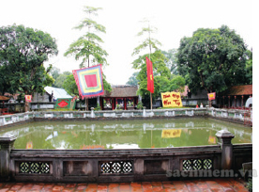
1. Match the words with the pictures:
1. The Temple of Literature
a
b
2. Thien Quang Tinh Well
3. Doctors’ stone tablets
4. Van Mieu Gate
5. Khue Van Pavilion
d
e
c

Slide 3
Unit 6:
THE FIRST UNIVERSITY IN VIET NAM
Lesson 2: A CLOSER LOOK 1

Slide 4

* New words:
- Cultural /ˈkʌltʃərəl/ (a)
Thuộc về văn hóa
- Heritage /ˈherɪtɪdʒ/(n)
Di sản
- Architectural /ˌɑːrkɪˈtektʃərəl/(a)
Thuộc về kiến trúc

Slide 5
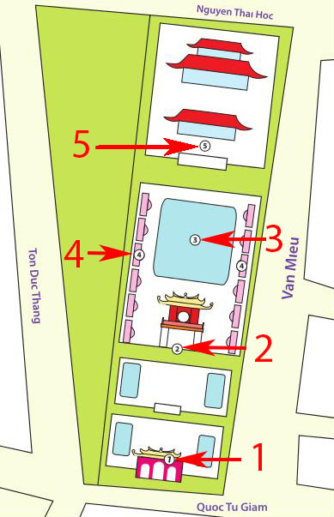
2. Read the names in 1 again and listen to the recording. Complete the layout of the Temple of Literature – the Imperial Academy.
1. Van Mieu Gate
2. Khue Van Pavilion
3. Thien Quang Tinh Well
4. Doctors’ stone tablets
5. The Temple of Literature

Slide 6
3. With a partner, use the prepositions in the box below to describe the layout of the Temple if Literature – The Imperial Academy. Share your descriptions with the class.
in
in front of / at the back of
behind
in the middle of
between
next to

Slide 7
Example:
- Khue Van Pavilion is in front of Thien Quang Tinh Well.
Van Mieu is at the back of Thien Quang Tinh Well.

Slide 8
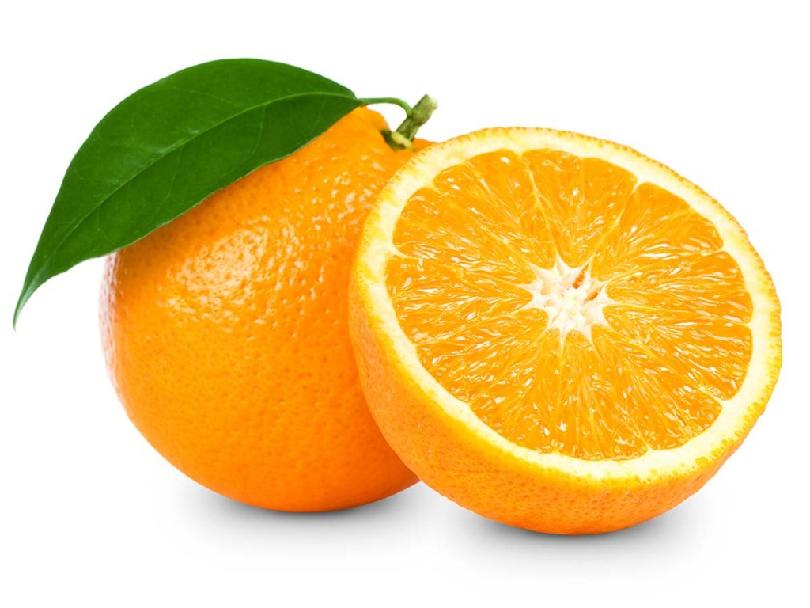
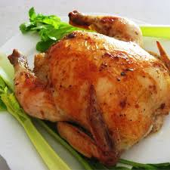
Orange
/ˈɔːrɪndʒ/
Chicken
/ˈtʃɪkɪn/

Slide 9


Slide 10
4. Listen and write the words in the correct columns.
/tʃ/ and /dʒ/
teach
question
chair
village
cultural
heritage
jeans
architectural
engineer
children
job
watch
/tʃ/ | /dʒ/

Slide 11





60
55
0
5
50
10
45
15
40
20
35
25
30
HẾT THỜI GIAN
đồng hồ đếm ngược 60 giây

Slide 12

4. Listen and write the words in the correct columns.
/tʃ/ and /dʒ/
teach
question
chair
village
cultural
heritage
jeans
architectural
engineer
children
job
watch
/tʃ/ | /dʒ/

Slide 13
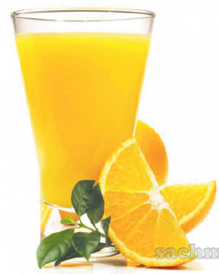
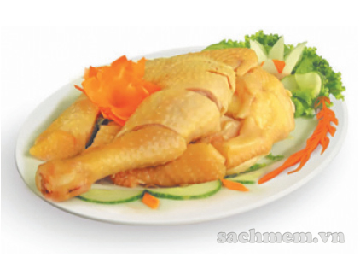
5. Listen and repeat the chants.
ORANGE
Orange juice, orange juice,
Cherry jam, cherry jam,
Which one is cheaper for children?
Orange juice is cheap.
Cherry jam is cheaper.
CHICKEN
Chicken chop, chicken chop,
Chip chop, chip chop,
Who likes chicken chop for lunch?
John likes chicken chop.
Jill likes pork chop.

Slide 14
6. Write the words from 5 with the sound /tʃ/ and /dʒ/ in the right columns.
/tʃ/ | /dʒ/
cherry
chop
orange
which
chip
juice
cheaper
lunch
jam
children
John
cheap
Jill
chicken

Slide 15
60
55
0
5
50
10
45
15
40
20
35
25
30
HẾT THỜI GIAN
đồng hồ đếm ngược 60 giây

Slide 16
6. Write the words from 5 with the sound /tʃ/ and /dʒ/ in the right columns.
/tʃ/ | /dʒ/
cherry
chop
orange
which
chip
juice
cheaper
lunch
jam
children
John
cheap
Jill
chicken

Slide 17

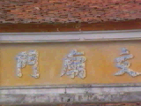
Homework
- Learn new words by heart.
- the sounds /tʃ/ and /dʒ/.
- Do exercises A1, A2; b3, b4 workbook.
- Prepare for Unit 6: Closer look 2.
+

Slide 18
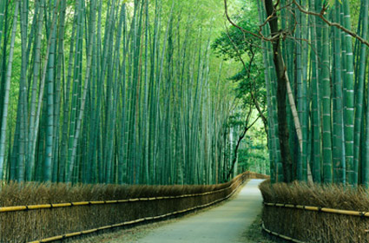
THANKS FOR YOUR ATTENTION!
Goodbye!
See you again!

